Slide 1
Custom Objects
Build Me

Slide 2
OBJECTS
Objects are individual customized constructs built from templates.

Slide 3
OBJECTS
Javascript gives you the ability to supersede the template designing process and build custom objects on the fly.

Slide 4
DATA GALLERY
Included with this Powerpoint Presentation is a file called datagallery.html. Please open that code in your editor and make the adjustments to it as you follow along with the slides.

Slide 5
BACK END DATA
Unlike previous examples, we will store our data in back end objects and then use them to drive the display.

Slide 6
CUSTOM OBJECTS
A custom object is easy to create. This is a sample.

Slide 7

CUSTOM OBJECTS
You can then populate the object with information.

Slide 8
CUSTOM OBJECTS
Using the dot (.) operator, you can create any property you like and give it any appropriate value.

Slide 9
BUILDING THE OBJECTS
For this particular project, we’ll be building objects based on data from the included Javascript file.

Slide 10
BUILDING THE OBJECTS
For this particular project, we’ll be building objects based on data from the included Javascript file.

Slide 11
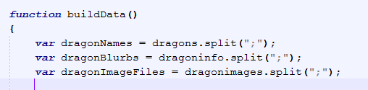
BUILDING THE OBJECTS
The data is built into semi-colon delimited strings, which we’ll split up into chunks.

Slide 12
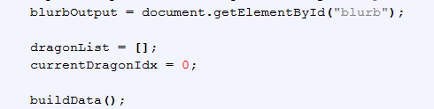
BUILDING THE OBJECTS
Since we have multiple dragons, we’re going to need to store them in an array and keep track of the current dragon (which will change based on user selection).
Add the following code to initialize.

Slide 13
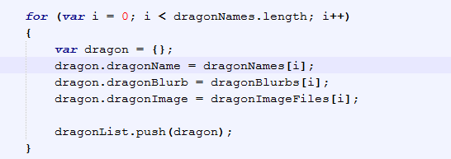
BUILDING THE OBJECTS
We’re also going to need to build the objects in a loop.

Slide 14
BUILDING THE OBJECTS
The number of iterations can be based on the number of elements in any one of the data arrays.

Slide 15
BUILDING THE OBJECTS
Throughout each iteration, you need to build a new object and populate it with the data.

Slide 16
BUILDING THE OBJECTS
Finally, push the completed object into the global array.

Slide 17
BUILDING THE OBJECTS
The dragon object is temporary and overwritten during every new iteration of the loop.

Slide 18
BUILDING THE OBJECTS
When it is pushed into the array, it is saved as an item in the array. That continues to be our only reference to it for the life of the program.

Slide 19
THE THUMBNAILS
We will now use the data we brought in to set the sources of the thumbnails.

Slide 20
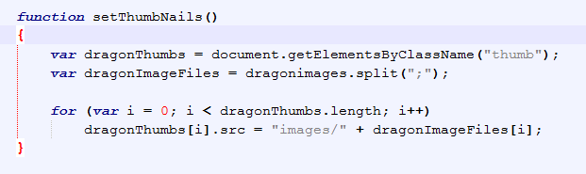
THE THUMBNAILS
We need a temporary array of the image elements and the image filenames from the data file.

Slide 21
THE THUMBNAILS
We iterate through the thumbnails, setting each <img /> element’s src attribute based on the image file stored in the dragon object.

Slide 22
THE THUMBNAILS
Note that the path is specific to the page and not contained in the data file. That’s why it’s explicitly written.

Slide 23
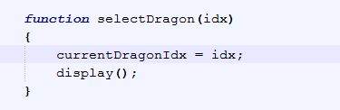
SELECT A DRAGON
Now create a function that selects that current dragon.

Slide 24
SELECT A DRAGON
We don’t know which dragon has been selected, so a parameter is created to receive that information.

Slide 25
SELECT A DRAGON
That index will be used to set the global variable.
Then we’ll call display so the user can see the change.

Slide 26
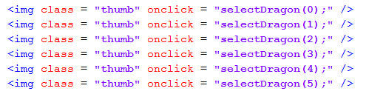
SELECT A DRAGON
The function calls go into the <img /> elements. Each one will specify an index.

Slide 27
SELECT A DRAGON
Each thumbnail was paired with an object, by index, in the setThumbnails() function.

Slide 28
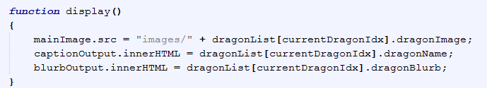
DISPLAY
The display handles all of the output.

Slide 29
DISPLAY
The HTML Elements that need updating have been stored in global Javascript objects.

Slide 30
DISPLAY
Their src and innerHTML properties are filles with information coming directly from the selected dragon.

Slide 31
SEAUENCE
If you follow the flow of the page, you’ll see that it runs all of its setup through initialize, building the structure and preparing the page for use by a client.
It then runs from click to back end update to display to waiting for another click.

Slide 32

MODEL-VIEW-CONTROLLER (MVC)
This is known as the Model-View-Controller system.

Slide 33
ABSTRACTION
A second data file has been included with this Powerpoint Presentation. It is the same data, but given in a different format. It is designed to be used with a generic Data Gallery that can read in any data so long as it appears in the format:
Item Name:Item Information:Item Image Name
Each full item is delimited by a semi-colon.
Can you write a generic Data Gallery?

